Slide 1
DESIGN PATTERN Strategy pattern & Factory pattern
Author: Phu Dinh Nguyen
Supervisor: An Le

Slide 2
Agenda
Design Pattern introduction
Types of design pattern
Strategy pattern
Factory pattern

Slide 3
Design Pattern introduction
Solutions for common problems in design.
Arrangement the interactions between individual software components.
Design patterns based on design principles.

Slide 4
Types of design pattern
Creational pattern
Structural pattern
Behavioral pattern
Solutions to instantiate a object
Solutions to create a class structure
Solutions for the better interaction between objects

Slide 5

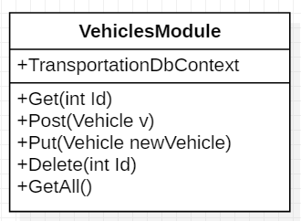
Strategy pattern
Situation:
Change database => Open close principle

Slide 6
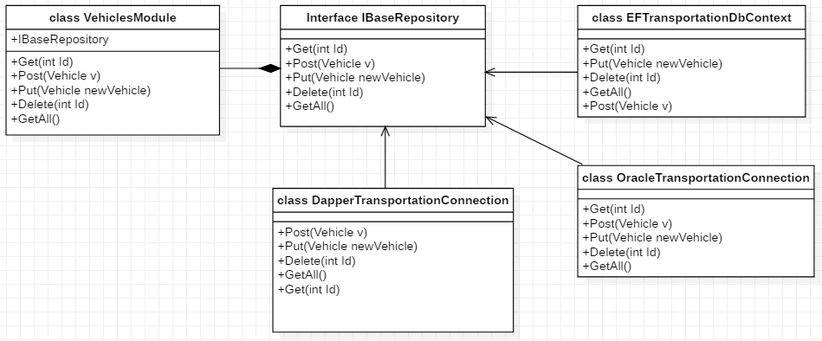
Strategy pattern
Solution:

Slide 7
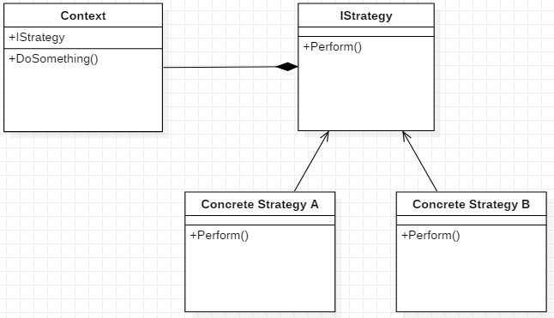
Strategy pattern
General Model:

Slide 8
Strategy pattern
Belong to behavioral pattern
Abide by “Open-close principle” and “Dependency inversion principle”
Easy for extensibility
Choice of implementation

Slide 9
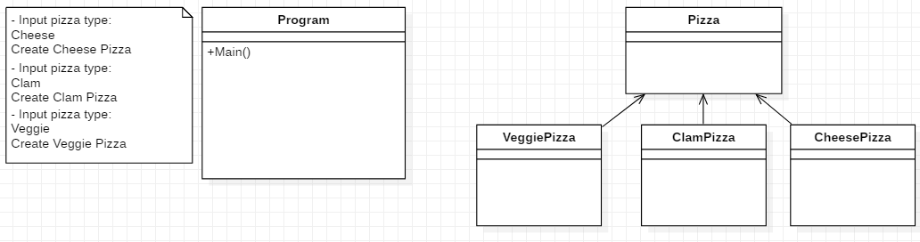
Factory Pattern
Situation:

Slide 10

Factory Pattern
Situation:
- Buy new pizza type => Open close principle
- Need to create pizza in other places => Duplicated code

Slide 11
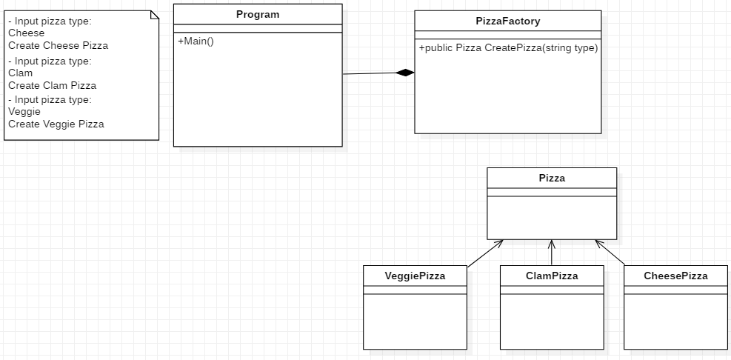
Factory Pattern
Solution (Simple Factory Pattern):

Slide 12
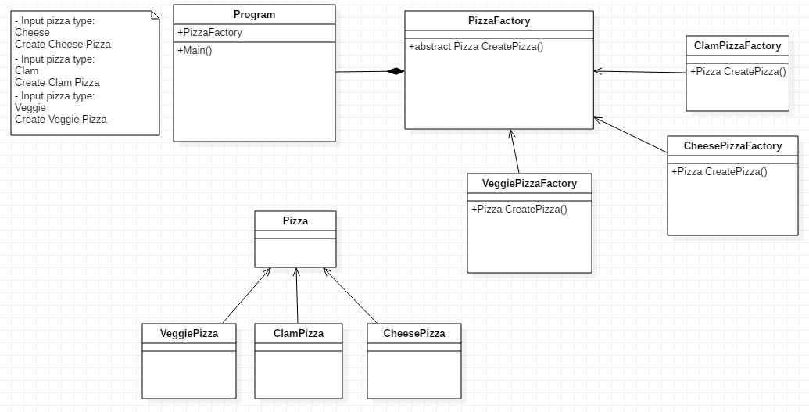
Factory Pattern
Better Solution (Factory Method Pattern):

Slide 13
Factory Pattern
Is creational pattern
Delegate creation process to an individual class
Adding new classes without breaking “Open close principle”
Easy to integrate the third party facilities

Slide 14
Application with Strategy and Factory

Slide 15
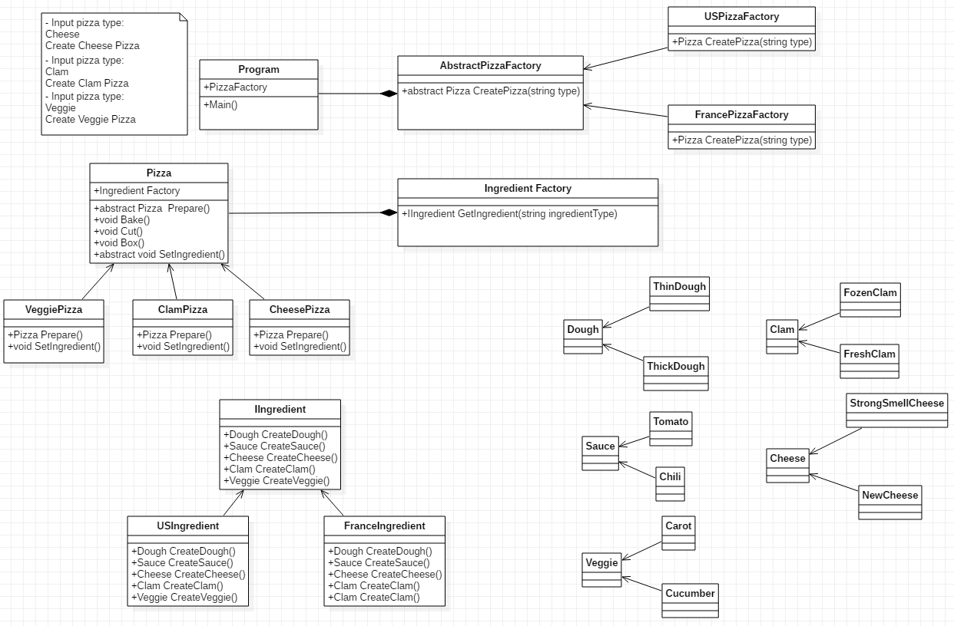
Application with Strategy and Factory

Slide 16
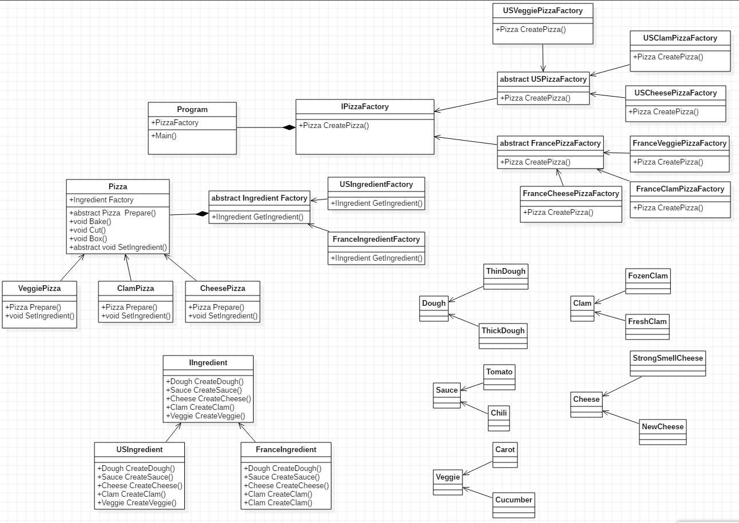
Application with Strategy and Factory

Slide 17
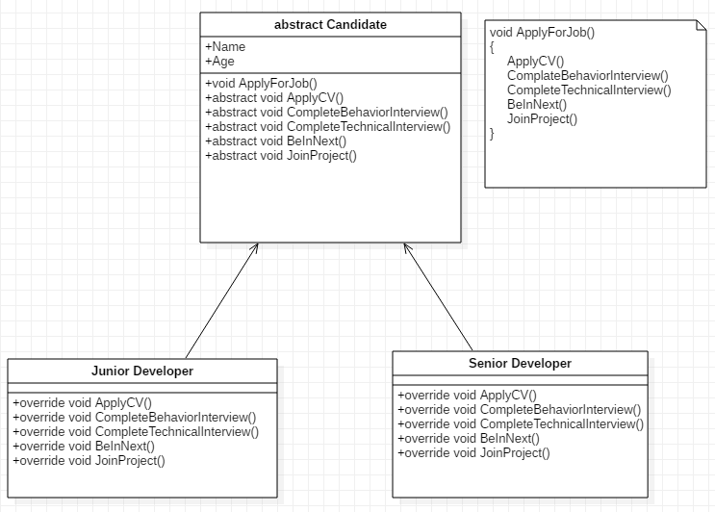
Template Pattern
Real example:
The skeleton of the algorithm has already introduced and will not change throughout the operation process. The algorithm operates without changing the structures.
Subclasses have a capability of redefining the certain steps of an algorithm, but changes will not affect the core architecture.

Slide 18
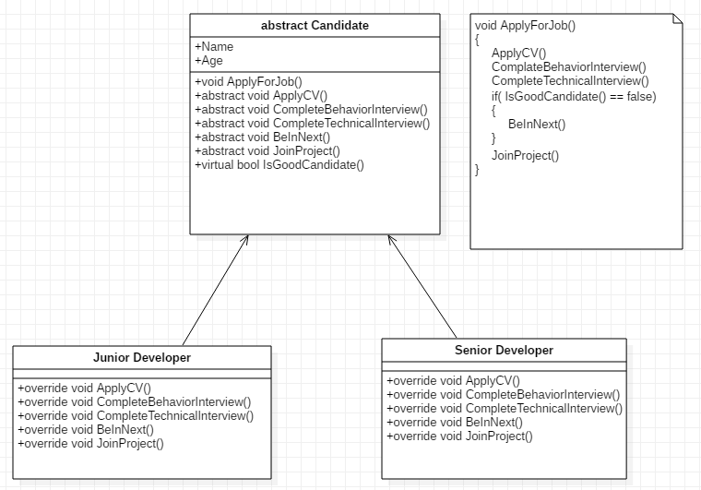
Template Pattern
Situation:
Be in NEXT is not compulsory
Ex: Good candidates will be accepted to the project after interviewing instantly.
=> Hook
Notes:
Hook is a method that can help you to control some kind of flow in an algorithm. IsGoodCandidate(): Các subclasses có thể override lại method này để introduce 1 implementation khác

Slide 19
References
Factory-Patterns.pptx – (Gang-of-4)
Strategy (Anne Ryan)
“Design Patterns Library” course in Plural Sight (Scott Allen, John Sonmez, David Starr, Robert Horvick, Steve Smith, Brian Lagunas, Keith Sparkjoy, Donald Belcham, Niraj Bhatt, John Brown, and Glenn Block)

Slide 20
Thanks!
Any questions ?
You can find me at
Email: phudinhnguyen@kms-technology.com

